Slide 1

Ho Chi Minh City University of Transport
Image Processing and Computer Vision
Contour Detection
Tran Le Anh
anhtl@ut.edu.vn
04-2025

Slide 2
Contour Detection

Slide 3
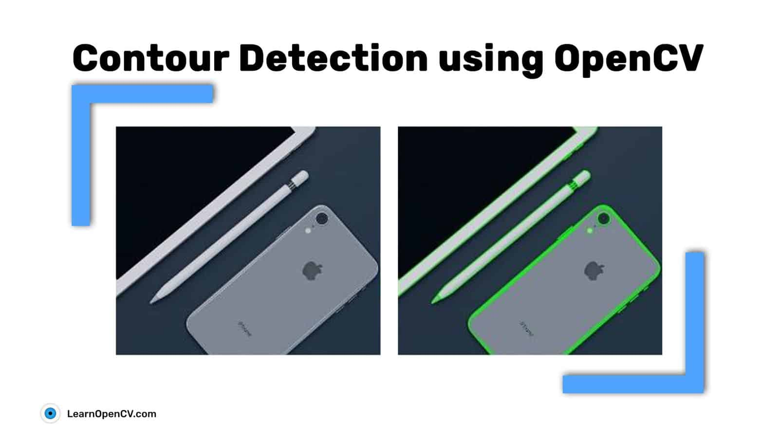
Contour Detection
Concept
- A contour refers to all the points on the boundary of an object that have the same color and intensity.
- Contour detection refers to methods for extracting and tracking the borders of objects, which is often the first step for image-foreground extraction, image segmentation, detection and recognition, etc.
Ref: https://learnopencv.com/contour-detection-using-opencv-python-c/

Slide 4
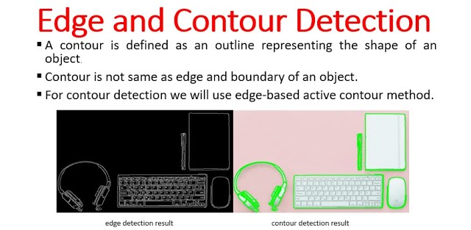
Contour Detection
Edge vs Contour
- Edge detection focuses on finding points where there are sharp changes in intensity within an image.
- Contour detection aims to identify closed curves or shapes, essentially outlining the boundaries of objects.
Ref: https://www.youtube.com/watch?v=oI9Qz3ri2y0

Slide 5
Contour Detection
Applications
- Motion Detection
- Background/Foreground Segmentation
Ref: https://learnopencv.com/contour-detection-using-opencv-python-c/

Slide 6
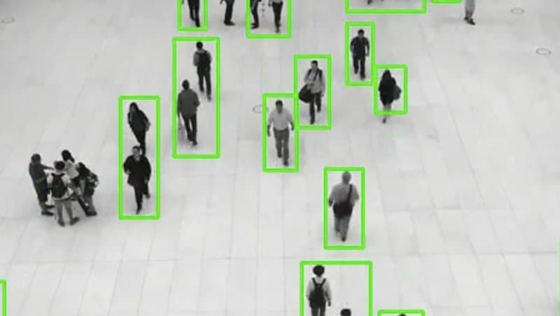
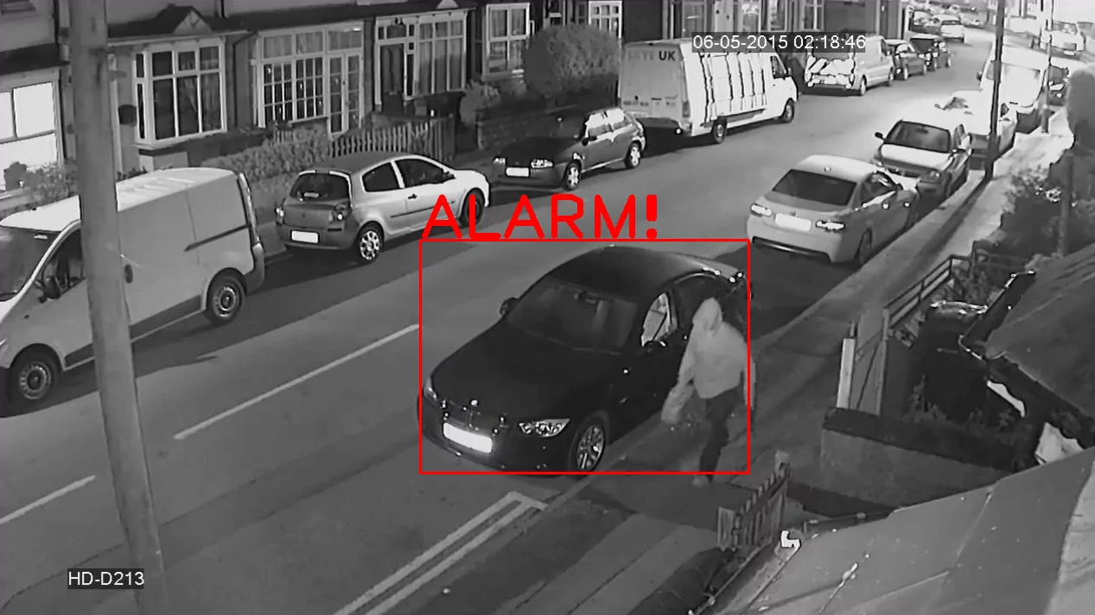
Contour Detection
Motion Detection
- To detect the movement of people in a video stream, which is useful in surveillance applications.
- Note that objects standing still are not detected, only those in motion are captured.
Ref: https://learnopencv.com/contour-detection-using-opencv-python-c/

Slide 7
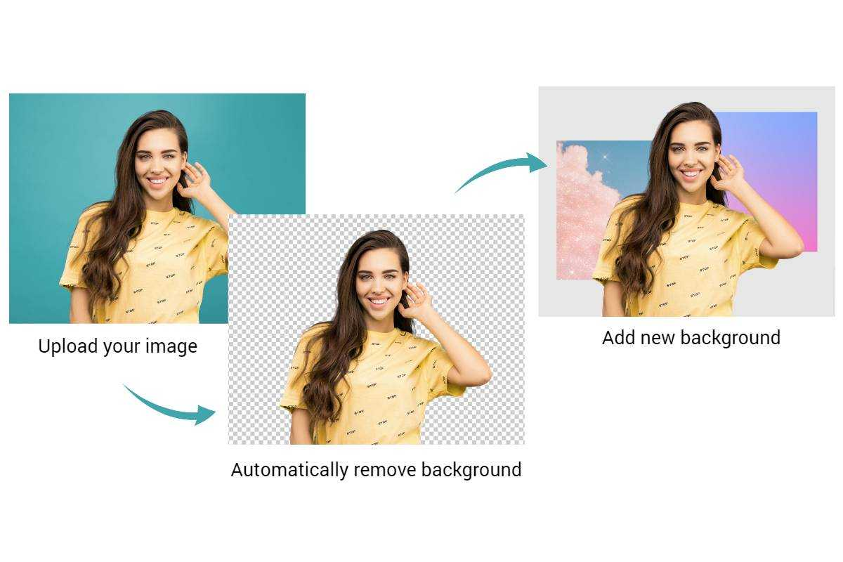
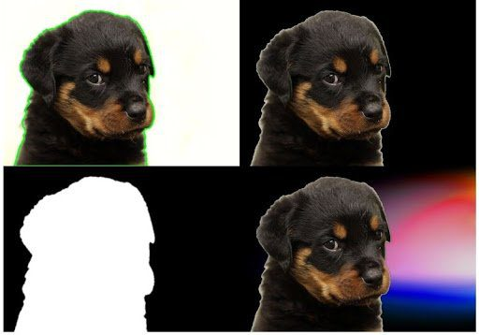
Contour Detection
Background/Foreground Segmentation
- To replace the background of an image with another (similar to image segmentation).
Ref: https://learnopencv.com/contour-detection-using-opencv-python-c/

Slide 8
Contour Detection
Techniques
- Contour Approximation
- Active Contour Model
- Deep Learning

Slide 9
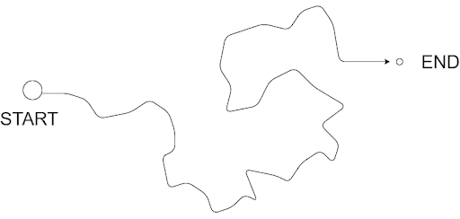
Contour Detection
Contour Approximation
- Contour approximation, which uses the Ramer–Douglas–Peucker (RDP) algorithm, aims to simplify a polyline by reducing its vertices given a threshold value.
Top-down view of a route
Contour Approximation in action
Ref: https://pyimagesearch.com/2021/10/06/opencv-contour-approximation/

Slide 10
Contour Detection
Contour Approximation
- Contour approximation, which uses the Ramer–Douglas–Peucker (RDP) algorithm, aims to simplify a polyline by reducing its vertices given a threshold value.
Ref: Ramer–Douglas–Peucker algorithm

Slide 11
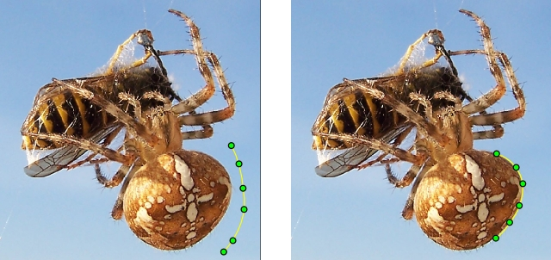
Contour Detection
Active Contour Model
- Active contour model (also called snakes) is a framework in computer vision introduced by Michael Kass, Andrew Witkin, and Demetri Terzopoulos for delineating an object outline from a possibly noisy 2D image.
- The snakes model is popular in computer vision, and snakes are widely used in applications like object tracking, shape recognition, segmentation, edge detection and stereo matching.
Ref: Active contour model

Slide 12
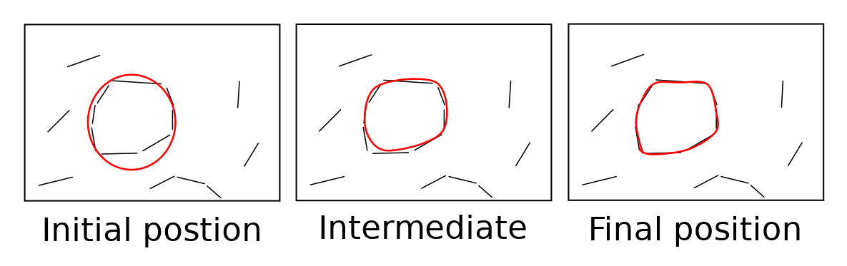
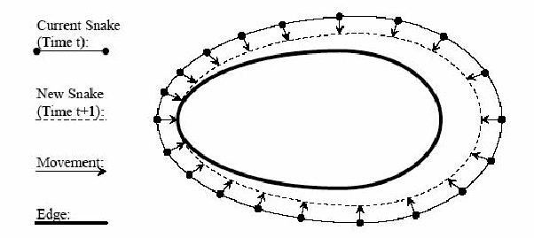
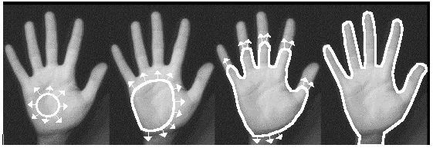
Contour Detection
Active Contour Model
Ref: https://rand-asswad.xyz/active-contour-models/

Slide 13
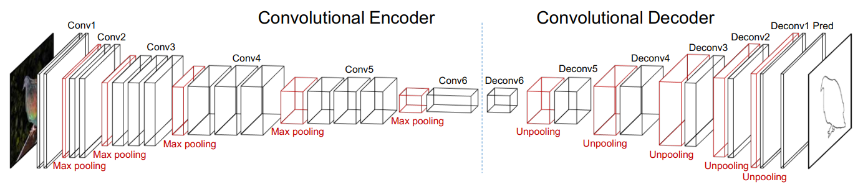
Contour Detection
Deep Learning
- Deep learning models can also be used for contour detection, learning to predict contour maps from images.
Ref: Object Contour Detection with a Fully Convolutional Encoder-Decoder Network

Slide 14
Contour Detection
Practice
- Contour Detection

Slide 15
Thank You
anhtl@ut.edu.vn

